Slide 1

AI-Powered Medical E-Card System for Specialists Recommendations
BY
Karan Saji Vethody - 22106023
Suraj Vishwakarma - 22106019
Disha Waghmare- 22106033
Shikshita Yadav - 22106092
Project Guide
Dr. Jaya Gupta

Slide 2
Outline
Introduction
Literature Survey of the existing systems
Limitations of the existing systems
Problem statement
System Design
Framework/ Algorithm
Technologies and methodologies
Implementation
Conclusion
References

Slide 3
Introduction
Revolutionary Healthcare Shift: The AI-powered Medical E-Card System is leading a major transformation in healthcare.
AI-Enhanced Referral Process: Utilizes advanced AI to streamline and improve specialist care referrals.
Comprehensive Digital Repository: Serves as a digital repository for detailed patient data, including medical histories, diagnostic results, and ongoing treatments.
Real-Time Data Analysis: Processes and analyzes vast amounts of patient data in real-time for accurate and timely specialist recommendations.
Enhanced Patient Care: Improves the efficiency and accuracy of connecting patients with the right specialists based on comprehensive data.

Slide 4
Motivation:
Enhance the efficiency and accuracy of the specialist referral process.
Ensure patients are quickly and accurately connected with the most appropriate specialists.
Leverage AI to analyze complex medical data for personalized recommendations.
Integrate diverse data sources, such as medical history and genetics, to support personalized medicine.
Improve patient outcomes by providing timely and relevant care.
Facilitate the shift towards data-driven, personalized healthcare solutions.
Objective:
Develop a seamless, efficient, and accurate tool for personalized specialist referrals.
Automatically analyze patient data to match individuals with the right medical experts.
Enhance patient care by ensuring appropriate and timely specialist recommendations.
Improve the overall efficiency of the healthcare process by reducing referral time and effort.
Minimize errors in the referral process.
Support the integration of personalized medicine into everyday clinical practice.

Slide 5
Literature Survey of the existing system
Research Paper | Summary | Limitation | Adaption
Deep Learning for Healthcare Recommendation Systems: A Survey (2022) | Xiao et al. review deep learning in healthcare, focusing on diagnosis, treatment, and personalized medicine, while addressing data privacy and interpretability challenges. | Data privacy, large dataset needs, model interpretability, generalizability, and potential bias. | Challenges in adapting deep learning to healthcare, including data privacy, dataset size, interpretability, and bias.
Healthcare Recommendation Systems: A Systematic Review (2022) | Kumar et al. review healthcare recommendation systems, highlighting collaborative and content-based filtering methods along with challenges like data quality and privacy. | In healthcare recommendation systems, including data quality, privacy, and interpretability issues. | Challenges in adapting healthcare recommendation systems, emphasizing data quality, privacy, and interpretability.
AI-Powered Personalized Medicine: A Survey of Healthcare Recommendation Systems (2022) | Lee et al. review AI in personalized healthcare recommendation systems, highlighting benefits like accuracy and challenges such as data privacy, bias, and interpretability. | In AI-powered healthcare recommendation systems, including data privacy concerns, bias, and challenges with model interpretability. | Adaptation challenges for AI-powered healthcare recommendation systems, focusing on data privacy, bias, and model interpretability.

Slide 6
Literature Survey of the existing system
Research Paper | Summary | Limitation | Adaption
Expert Systems: Definitions, Advantages and Issues in Medical Field Applications. (2021) | Saibene, Assale, and Giltri review expert systems in medicine, focusing on clinical decisions and challenges like reliability and integration. | Expert systems in medicine, including reliability and integration challenges.. | Challenges in adapting expert systems in medicine, focusing on reliability and clinical integration.
HealthRec: A Deep Learning-Based Healthcare Recommendation System (2019) | Chen et al. explore deep learning in HealthRec, emphasizing treatment recommendations and prediction accuracy, while addressing data quality and integration challenges. | In using deep learning for HealthRec, including data quality, system integration, and managing diverse patient data. | Challenges in adapting deep learning for HealthRec, including data quality, system integration, and managing diverse patient data.
Medical Expert Systems Survey (2017) | Abu-Nasser surveys medical expert systems, exploring their development, applications, and effectiveness in diagnosis and treatment planning. | Medical expert systems, including diagnostic accuracy, system complexity, and integration challenges. | Adaptation challenges for medical expert systems, focusing on system complexity, integration, and diagnostic accuracy.

Slide 7
Limitations
Data Quality and Availability: These systems heavily rely on the quality and availability of data. Inaccurate or incomplete patient data can lead to erroneous recommendations.
Bias and Fairness: AI models can inherit biases present in the data used for training, potentially leading to unfair or inequitable recommendations across different demographic groups.
Interpretability: Deep learning models used in these systems often lack transparency, making it difficult for healthcare providers to understand how recommendations are generated.
Integration with Existing Systems: Compatibility and integration with existing healthcare IT infrastructure and electronic health records (EHR) systems can be challenging, affecting the adoption and usability of AI recommendations.

Slide 8
Problem statement
The problem statement for an AI-powered medical e-card system for specialist recommendations revolves around several key challenges. Integrating diverse data sources, such as EHRs and patient history, into a standardized and interoperable system is crucial for accurate recommendations. Ensuring high accuracy and reliability is essential to avoid delays or incorrect care. Data privacy and security must be rigorously maintained to comply with regulations. The system must also be interpretable to build trust among healthcare professionals, while addressing biases to ensure fairness. Scalability and adaptability to various medical contexts are needed, along with seamless integration into existing workflows and effective user training for successful adoption.

Slide 9
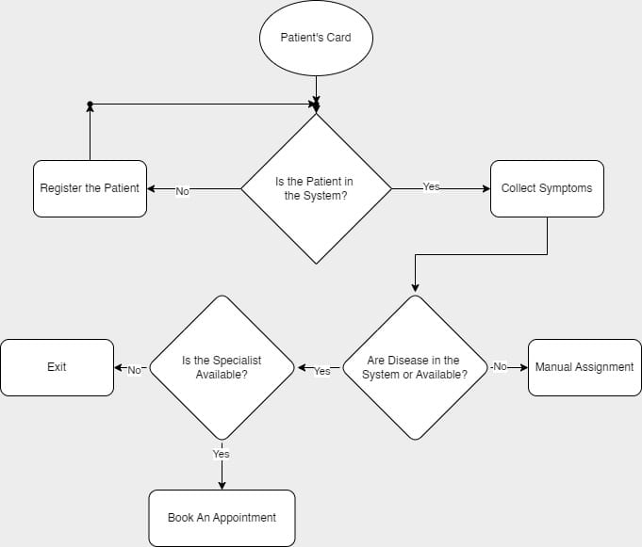
System Design

Slide 10
Framework/Algorithm
Logistic regression: Logistic Regression is a binary classification model that predicts the probability of an outcome using the logistic function. It’s best for linear relationships between features and the target and outputs probabilities between 0 and 1.
Support Vector Machine: SVM is a supervised learning algorithm that finds the optimal hyperplane to separate classes in high-dimensional space. It can handle both linear and non-linear classification using kernel functions.
K-Nearest Neighbors: KNN classifies samples based on the majority class of their k-nearest neighbors. It’s non-parametric and sensitive to the choice of distance metric and the number of neighbors (k).
Random Forest: Random Forest is an ensemble method combining multiple decision trees to improve classification or regression accuracy. It reduces overfitting and provides feature importance, making it effective for complex tasks.

Slide 11
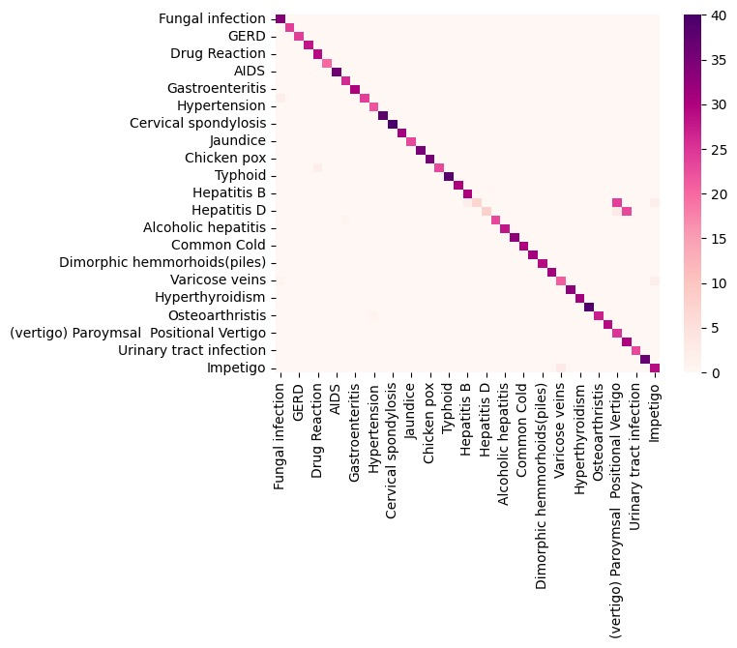
Implementation
CONFUSION MATRIX
F1-score% = 94.10676945338828
Accuracy% = 94.6341463414634

Slide 12
Technologies and methodology
Finding a suitable dataset that is relevant to the aim of our project.
Determining the usability of the dataset, cleaning the data (if required) and preprocessing the data.
Visualizing the dataset for better understanding of the data present in it.
Finding an apt Machine Learning algorithm that yields a great prediction accuracy.
Working on the overfitting of the model (in case it is overfitted)
Building a user interface that interacts with the patients in the front end.
Connecting the ML model in the back end to the front end.

Slide 13
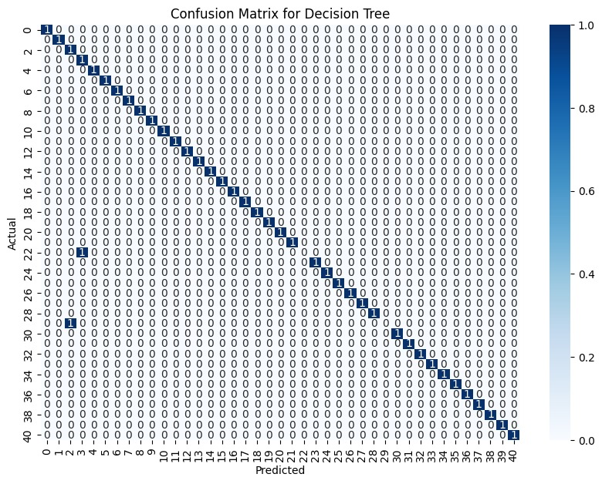
F1 Score for Decision Tree: 0.9349593495934958
Accuracy% =Between 93 to 95

Slide 14
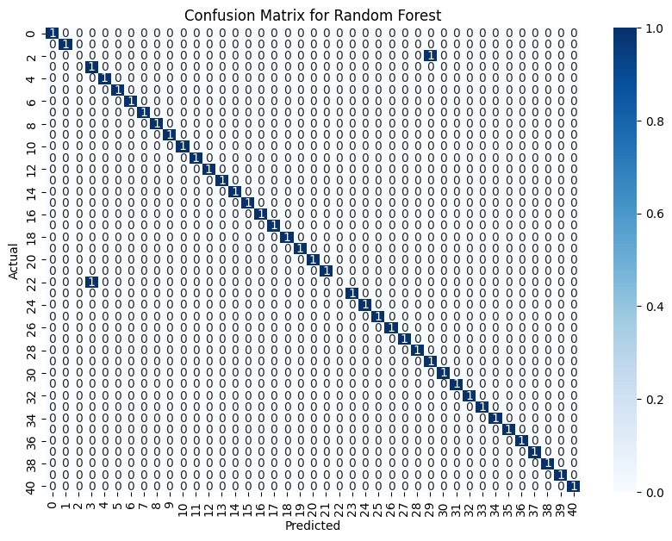
F1 Score for Random Forest: 0.9349593495934958
Accuracy% =Between 93 to 95

Slide 15

F1 Score for Naive Bayes: 0.9349593495934958
Accuracy% =Between 93 to 95

Slide 16
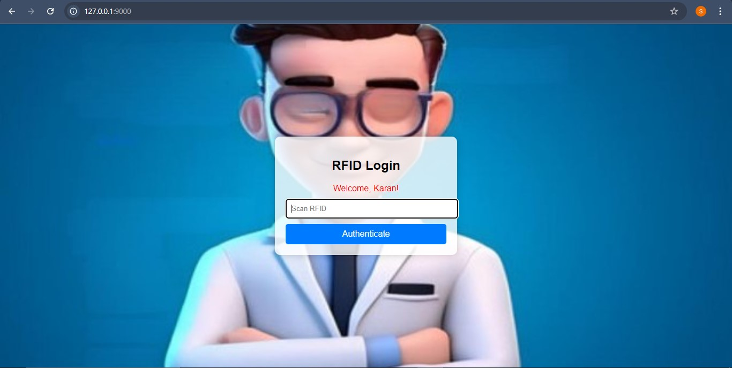

Slide 17
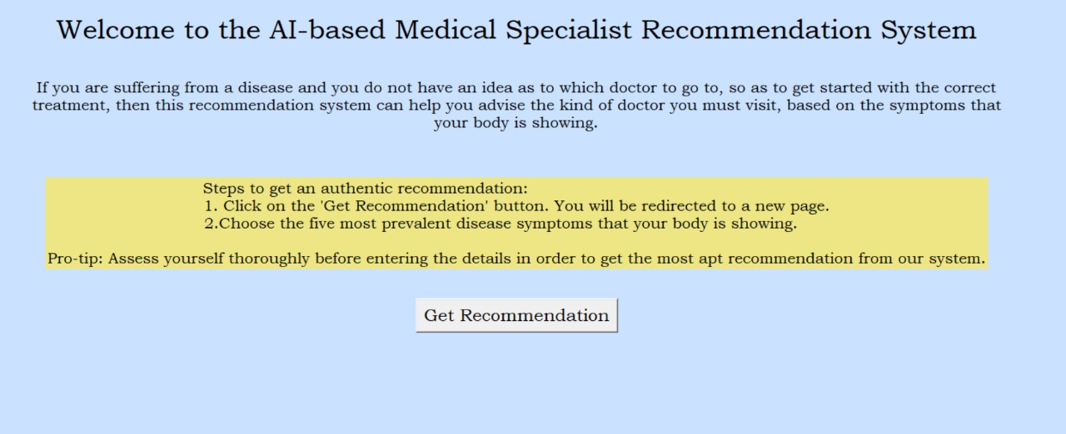

Slide 18
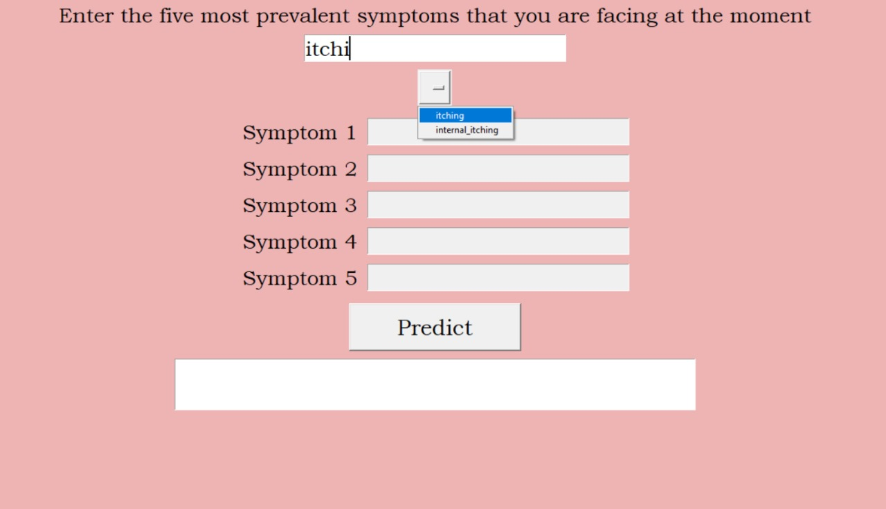

Slide 19
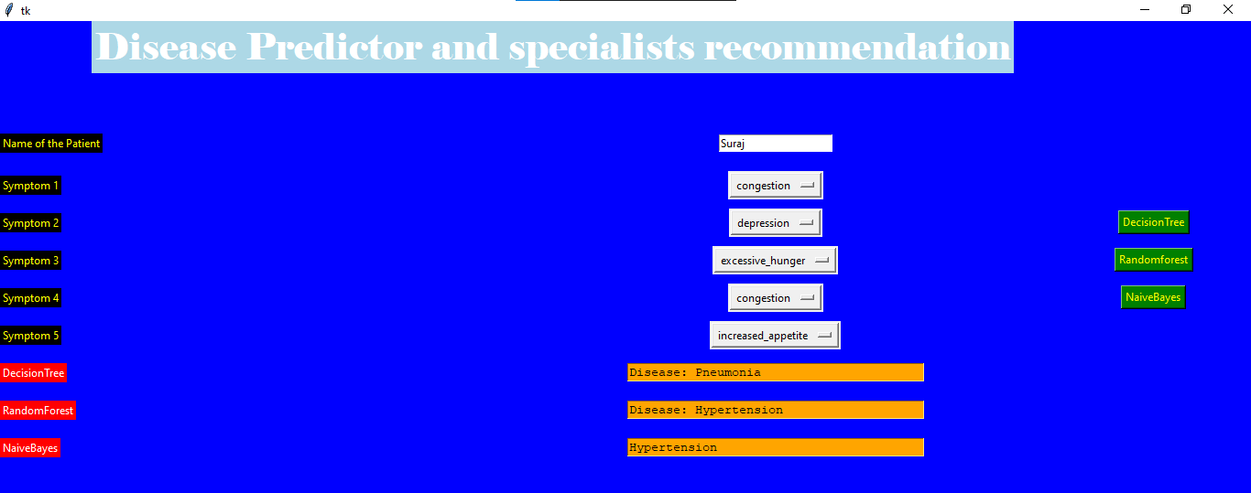

Slide 20
Conclusion
Transformative Approach: AI-powered medical e-card systems revolutionize personalized healthcare.
Advanced Algorithms: Utilize AI to analyze patient data and provide tailored specialist referrals.
Enhanced Accuracy and Efficiency: Significantly improve the accuracy and efficiency of the referral process.
Improved Patient Outcomes: Lead to better patient outcomes through precise and relevant recommendations.
Streamlined Healthcare Delivery: Contribute to a more efficient healthcare delivery system.
Integration of Diverse Data: Effectively integrate and interpret diverse data sources like EHRs and medical histories.
Better Care and Treatment Decisions: Facilitate more accurate care and treatment decisions based on comprehensive patient data analysis.

Slide 21
References
[1] Xiao et al., Deep Learning for Healthcare Recommendation Systems: A Survey, IEEE Access, Volume 10, 2022.
[2] Kumar et al., Healthcare Recommendation Systems: A Systematic Review, Journal of Healthcare Engineering, Volume 2022, 2022.
[3] Lee et al., AI-Powered Personalized Medicine: A Survey of Healthcare Recommendation Systems, Artificial Intelligence Review, Volume 55, 2022.
[4] Saibene, A., Assale, M., & Giltri, M., Expert systems: Definitions, advantages and issues in medical field applications, Expert Systems with Applications, Volume 177, Page 114900, 2021.
[5] Chen et al., HealthRec: A Deep Learning-Based Healthcare Recommendation System, IEEE Transactions on Neural Networks and Learning Systems, Volume 30, 2019.
[6] Abu-Nasser, B., Medical expert systems survey, International Journal of Engineering and Information Systems (IJEAIS), Volume 1(7), Pages 218-224, 2017

Slide 22
Thank You...!!

